Slide 1
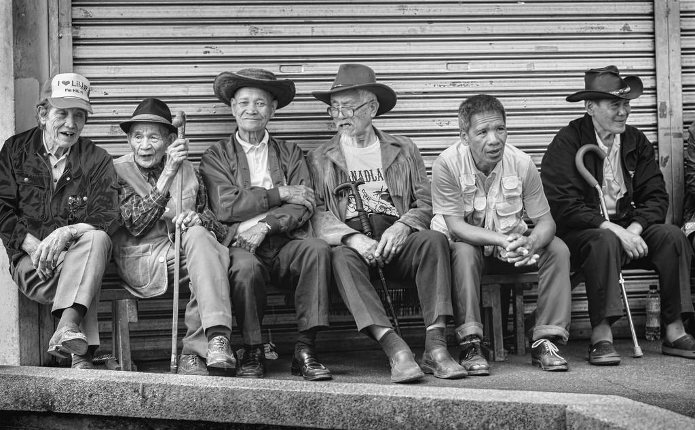

Relationships and Well-Being
[Professor Name]
[Class and Section Number]
Notes:
Class Recommendations: This module can be taught in one class.
Overview: The relationships and well-being module introduces students to idea of subjective well-being, including how to measure happiness and subjective well-being. The accompanying PowerPoint presentation provides material for your class, including activities and discussion questions, which are designed to help keep your students engaged in the material. This instructor’s manual includes discussion questions and activities to help you teach the material, and it includes links to other resources that may help you further personalize this portion of your course.
Technical Note: These slides may contain simple click animation so that you can focus students’ attention on a particular question, a selection of text, or an image and not have them be distracted by reading ahead. You can either preview the sequence of animation by going through the slides in slideshow view, visiting the animations tab, or reviewing the slide notes. In the notes you will see a cue - (Click) – that corresponds to each animation.
You may also find hyperlinks to outside videos at various places in the slides. These hyperlinks are embedded in text and indicated by color and in the notes section.

Slide 2
Learning Objectives
Understand why relationships are key to happiness and health.
Define and list different forms of relationships.
List different aspects of well-being.
Explain how relationships can enhance well-being.
Explain how relationships might not enhance well-being.
Notes:
This slide outlines the learning objectives of the module.

Slide 3

Warm Up: Relationships and Happiness
Porcupine Love
Notes:
This is an activity that could take place before looking at the overview of this module’s information. This purpose of this slide is to get students thinking about relationships and happiness.
(Click): Porcupine Love
This link goes to http://www.pbs.org/video/1275319877/, which is a 1 minute, 50 second clip from This Emotional Life, in which author Elizabeth Gilbert discusses how Schopenhauer discussed the need for relationships and the need for separation through porcupines. The clip ends with her saying finding the balance between these two needs is as close to the secret of happiness as I’ve ever learned.”
Gilbert says that finding a balance between the need to be belong and “need to be separated” is “as close to the secret of happiness as any I’ve ever learned.” Ask students what they think of this quote.
This clip and discussion prompt is designed to get students thinking about the relationship between relationships and happiness. It also sets them up for later information about how not all relationships are good, so not all relationships lead to happiness.

Slide 4
Overview
Measuring Happiness and Relationships
  Objective Social Variables
  Subjective Social Variables
  Subjective Well-Being
Relationships and Well-being
  Presence of Relationships
  Quality of Relationships
  Are relationships the secret to happiness?
Conclusion: A recipe for happiness?
Notes:
The purpose of this slide is to provide students with an overview of the material that will be covered during the lecture

Slide 5

Measuring Happiness and Relationships
How do psychologists measure concepts such as happiness and relationships?
  Operationalization
Notes:
The purpose of this slide is to introduce students to the concept of operationalization, as well as get them thinking about how to measure happiness and relationships.
(Click): How do psychologists measure concepts such as happiness and relationships?
Happiness is an abstract concept, and, in order to study happiness, psychologists need to find a way to measure it. This question gets students to think about the need to measure the concept for purposes of research and how we might do that.
(Click): Operationalization
The module discussed operationalization, and the glossary defines operationalize as “The process of defining a concept so that it can be measured. In psychology, this often happens by identifying related concepts or behaviors that can be more easily measured.” The next few slides will discuss specifically how happiness and relationships are operationalized in research.

Slide 6

Measuring Happiness and Relationships
Objective social variables
Factual
Based on evidence
Example: Social Integration
Notes:
This slide introduces the topic of objective social variables.
(Click): Objective social variables
Objective social variables measure relationships and aspects of relationships in a way that is factual and based on evidence. For example, some objective social variables are number of friends on Facebook or marital status.
(Click): Factual
These are measurements that are factual, not ones that are based on opinion.
(Click): Based on evidence
These variables are based on evidence. For example, number of friends on Facebook is a way to measure relationships that is based on evidence.
(Click): Example: Social Integration
One objective social variable is social integration, how connected people are to others in their social network, which can be measured by assessing the frequency and amount of social contact with others.

Slide 7

Measuring Happiness and Relationships
Subjective social variables
Opinions
Feelings
Example: Social support
Notes:
This slide introduces the topic of subjective well-being.
(Click): Subjective social variables
Subjective social variables are based on participants’ personal opinions rather than facts. These variables help researchers understand participants’ perceptions of their relationships. Some examples of subjective social variable are a person’s satisfaction with their relationships, their perception of the quality of their relationships, and the amount of conflict in their relationships.
(Click): Opinions
Unlike objective social variables that are based on fact, subjective social variables are based on opinion. Examples include your satisfaction with your relationship or your perception of the amount of conflict in your relationship.
(Click): Feelings
How much in love are you with your partner? How close to you feel to your friend? These are examples of subjective social variables.
(Click): Example: Social support
One example of a subjective social variable is social support, which is “the extent to which individuals feel cared for, can receive help from others, and are part of a supportive network.” Researchers who study social support will often ask participants about both the amount of and satisfaction with their social support.

Slide 8
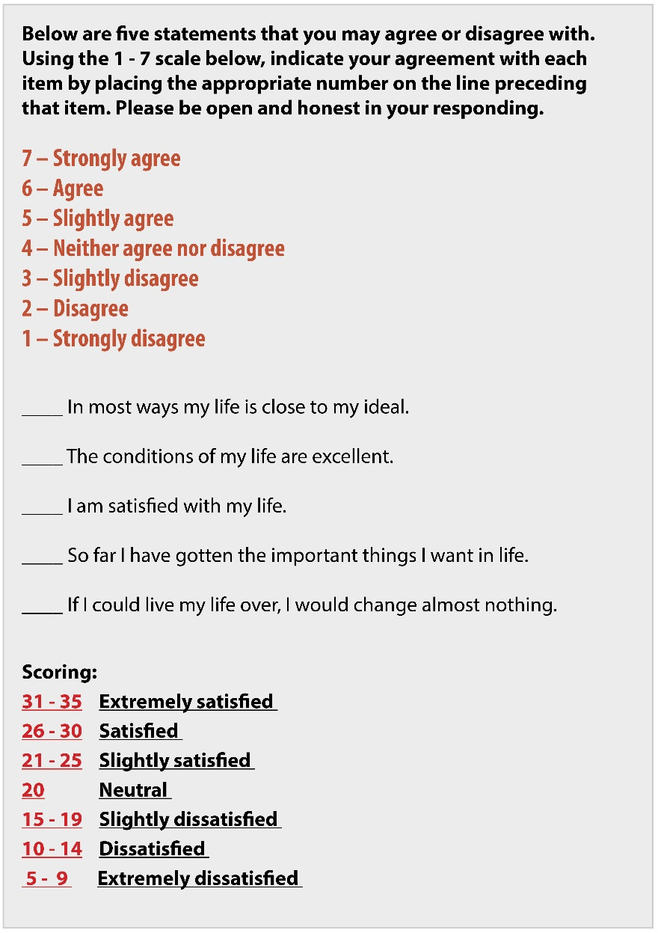
Satisfaction with Life Scale
Notes:
This slide contains the Satisfaction with Life Scale, which is also in the module. Have students spend a few minutes and complete the scale.
Reference:
Diener, E. D., Emmons, R. A., Larsen, R. J., & Griffin, S. (1985). The satisfaction with life scale. Journal of Personality Assessment, 49(1), 71-75.

Slide 9
Satisfaction with Life Scale
Notes:
This slide contains the Satisfaction with Life Scale, as well as how to score it. After students have taken the scale on the previous slide, have them add up their scores and find out where they rate on the scale. You can ask them if they are surprised or not by their rating. You will want to be sensitive in your explanation of the results, because there will likely be students who score low on the scale. You can point out that “So far I have gotten the important things I want in life” may be lower for them if one of the things they are working on is a college degree.
Reference:
Diener, E. D., Emmons, R. A., Larsen, R. J., & Griffin, S. (1985). The satisfaction with life scale. Journal of Personality Assessment, 49(1), 71-75.

Slide 10

Measuring Happiness and Relationships
Subjective well-being
Life satisfaction
Positive feelings
Low negative feelings
Notes:
This slide is discusses subjective well-being, which is often measured via self-report scales.
(Click): Subjective well-being
Happiness is a part of well-being, and psychologists’ term for happiness is subjective well-being. Subjective well-being has three components, which are also presented on the slide.
(Click): Life satisfaction
A person has high life satisfaction when they evaluate their life positively. This is one aspect of subjective well-being. The Satisfaction with Life Scale, presented on the previous two slides is one way to measure life satisfaction and well-being.
(Click): Positive feelings
The presence of positive emotions, such as joy and peace, are an aspect of subjective well-being.
(Click): Low negative feelings
One part of subjective well-being is experiencing low amounts negative emotions (e.g., anger and sadness).

Slide 11

Relationships and Well-Being
Presence of relationships
Ostracism and shunning
Notes:
The purpose of this slide is to discuss how the presence or absence of relationships affects well-being.
(Click) Presence of relationships
In attempting to understand how relationships influence well-being, researchers look at whether individuals have relationships. This is assessed with objective social variables, such as number of friends, size or social networks, or marital status. Past research has indicated the number of social relationships a person has is related to that person’s well-being.
(Click) Ostracism and shunning
Some researchers look at the absence of relationships, by studying social rejection, such as ostracism or shunning. Individuals’ well-being is negatively impacted when they are ostracized or shunned.

Slide 12
Overview
Measuring Happiness and Relationships
  Objective Social Variables
  Subjective Social Variables
  Subjective Well-Being
Relationships and Well-being
  Presence of Relationships
  Quality of Relationships
  Are relationships the secret to happiness?
Conclusion: A recipe for happiness?
Notes:
The purpose of this slide is to provide students with an overview of the material that will be covered during the lecture

Slide 13

Relationships and Well-Being
Quality of relationships
Quality over quantity
Notes:
The purpose of this slide is to discuss how the quality of relationships affects well-being.
(Click) Quality of relationships
Being married has associated with greater subjective well-being. This relationship, though, is dependent on the quality of the marriage, as a person’s satisfaction with their marriage is related to their satisfaction with their life. Also, people who rate their marriage quality as low were more likely to report being depressed, and some research indicates that the conflict between romantic partners can lead to lower ratings of subjective well-being. Since we don’t often have a choice about who we work with, researchers studying work relationships focus on quality of relationships with people you work with. People with positive work relationships are less stressed at work and find work more enjoyable.
(Click) Quality over quantity
Past research has indicated the number of social relationships is related to well-being, and well-being can be associated with a few high-quality relationships, which means people don’t necessarily have to have a lot of friends to experience subjective well-being. This may be an important point to emphasize, as some students may be in class thinking about their relative lack of friends.

Slide 14
Are Relationships the
Secret to Happiness?
Correlations
Relationships
Happiness
Happiness
Relationships
Relationships
Another factor
Happiness
Notes:
This slide uses a diagram to discuss the question, “Are relationships the secret to happiness?” Some psychologists believe that relationships are the key to happiness or subjective well-being. Others point out that much of this research is correlational, and that the correlations are often small.
(Click): Correlations
Some psychologists believe that relationships are the key to happiness or subjective well-being. Others point out that much of this research is correlational, and that the correlations are often small. Below is one issue with correlational research.
(Click): Relationships → Happiness
It may be that relationships cause happiness. Some research, for example, tracks people in their romantic relationships, and results indicate that people gain subjective well-being when they go from single to being in a relationship. They also tend to experience even more gains in subjective well-being when they get married.
(Click): Happiness → Relationships
It may be that we are more likely to make friends and connect with them more when we are happy. Also, we might be more likely to date when we are happy.
(Click): Another factor
It also could be that another factor, such as presence/absence of a psychological disorder, could affect both relationships and happiness. Being depressed, for example, can influence how happy a person feels as well as the quality of their relationships.

Slide 15
Overview
Measuring Happiness and Relationships
  Objective Social Variables
  Subjective Social Variables
  Subjective Well-Being
Relationships and Well-being
  Presence of Relationships
  Quality of Relationships
  Are relationships the secret to happiness?
Conclusion: A recipe for happiness?
Notes:
The purpose of this slide is to provide students with an overview of the material that will be covered during the lecture

Slide 16

A Recipe for Happiness?
Notes:
This slide concludes the topic with a reference to the last paragraph in the module. The module concludes by stating that relationships may not be the secret to happiness, but, if there is a recipe to happiness, then social relationships are one ingredient.
Possible discussion:
At this point, if you have time, you could ask students what they think about this conclusion. Do they think relationships are simply an ingredient or an essential ingredient to the recipe of happiness?

Slide 17

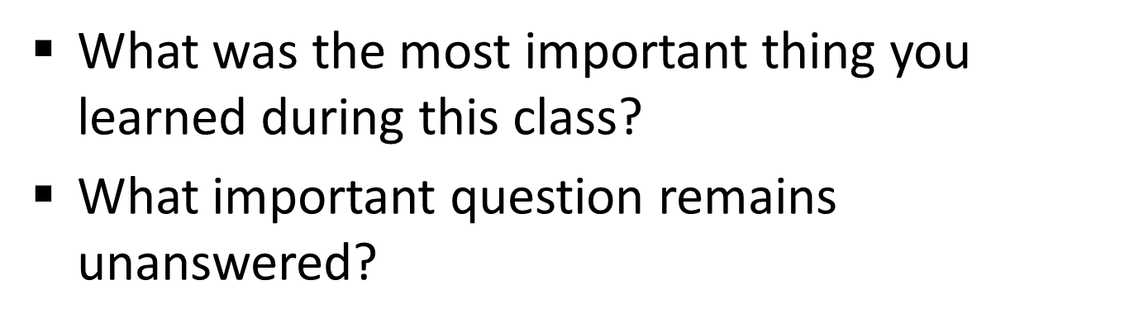
CAT: One-Minute Paper
Notes:
Classroom Assessment Technique (CAT): One-Minute Paper
If you are presenting the information on one class day, you might end the material about here. End your class time with a one-minute paper.
The Minute Paper tests how students are gaining knowledge, or not. The instructor ends class by asking students to write a brief response to the following questions: “What was the most important thing you learned during this class?” and “What important question remains unanswered?”
Have students briefly answer these questions in writing and turn them in. After class, assess students’ responses. At the beginning of the next class, go over any misunderstandings or relevant questions.
If you do not conclude with this Classroom Assessment Technique (CAT), it would helpful to use another CAT. It could be in the form of a:
Muddy point
One-minute paper
Background knowledge
What’s the Principle?
Defining features Matrix:
For more information on CATs click here: http://cft.vanderbilt.edu/guides-sub-pages/cats/

Slide 18
Photo Attribution
Slide 1 | Photo Credit: Six Kaibigans (friends) Wayne S. Grazio https://www.flickr.com/photos/94075184@N00/18733153589 https://creativecommons.org/licenses/by-nc-nd/2.0/
Slide 3 | Photo Credit: happiness sciondriver https://www.flickr.com/photos/minidriver/2333277924 https://creativecommons.org/licenses/by-nc/2.0/
Slide 5 | Photo Credit: happiness sciondriver https://www.flickr.com/photos/minidriver/2333277924 https://creativecommons.org/licenses/by-nc/2.0/
Slide 6 | Photo Credit: IMG_3221 徐薰 https://www.flickr.com/photos/57798009@N03/5577762578 https://creativecommons.org/licenses/by/2.0/
Slide 7 | Photo Credit: Diversity ambroochizafer https://pixabay.com/en/diversity-happy-people-young-smile-1034160/ https://creativecommons.org/publicdomain/zero/1.0/deed.en
Slides 8 & 9 | Image Credit: Created using information from: Diener, E. D., Emmons, R. A., Larsen, R. J., & Griffin, S. (1985). The satisfaction with life scale. Journal of Personality Assessment, 49(1), 71-75.
Slide 10 | Photo Credit: Sweet Notes Singing Viewminder https://www.flickr.com/photos/27869077@N05/5888703456 https://creativecommons.org/licenses/by-nc-nd/2.0/
Slide 11 | Photo Credit: black and white woman sitting gratisography.com https://www.pexels.com/photo/black-and-white-woman-girl-sitting-2369/ https://creativecommons.org/publicdomain/zero/1.0/deed.en
Slide 13 | Photo Credit: Couple Unsplash https://pixabay.com/en/couple-african-happy-man-woman-1030744/ https://creativecommons.org/publicdomain/zero/1.0/deed.en
Slide 14 | Image Credit: Noba Staff https://creativecommons.org/licenses/by-nc-sa/4.0/deed.en_US
Slide 16 | Photo Credit: pico ingredients Peter Hinsdale https://www.flickr.com/photos/peterpics924/1331313461/ https://creativecommons.org/licenses/by-nc-nd/2.0/
Slide 17 | Photo Credit: Photo Credit: Illustrated silhouette of a black cat nehtaeh79 http://www.freestockphotos.biz/stockphoto/16624 http://creativecommons.org/publicdomain/zero/1.0/
Notes:
Photo Attribution Slide

